Slide 1
Causes of World War 2
Treaty
Of
Versailles

Slide 2
Causes of World War 2
Rise of
Totalitarian
Dictators

Slide 3
Causes of World War 2

Slide 4
Causes of World War 2

Slide 5
Causes of World War 2

Slide 6
Causes of World War 2

Slide 7
Causes of World War 2
These dictators promised to get their nations out of the depression.
They would do this by putting people back to work building strong militaries.
These nations would need to take over areas that had resources every industrial nation needs
steel, rubber, OIL.

Slide 8
Appeasement at Munich Conference “Peace in our time”
Hitler is allowed to keep the areas he conquered-
Rhineland, Sudatenland, by the British and French because they feared another war.
1938

Slide 9
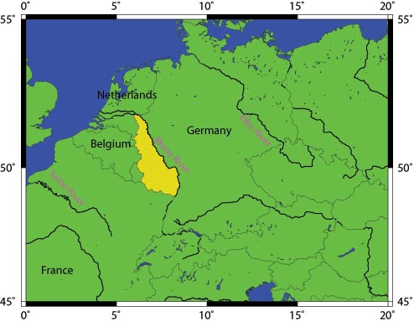

Slide 10
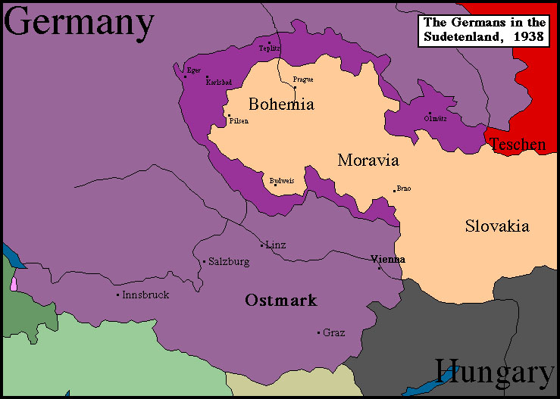

Slide 11
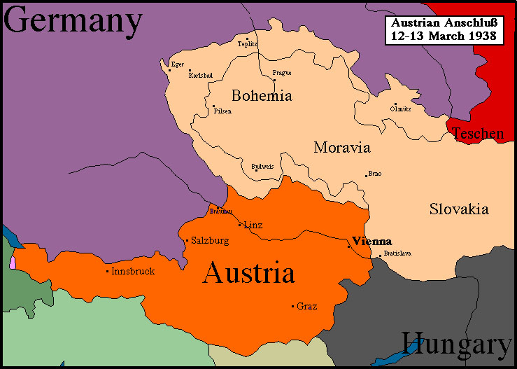

Slide 12
US Foreign Policy During Hitler’s Rise
Neutrality
No Trading w/nations at war

Slide 13
US Foreign Policy Changes
September 1, 1939 Hitler invades Poland and begins WW2 in Europe.
US will trade w/ nations at war if they give cash and carry supplies themselves.
Britain left to fight Hitler themselves the US lends and leases them war supplies-helping but not fighting.

Slide 14
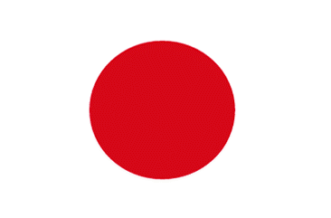
Problems with Japan
The U.S. and Japan had been competing for trading rights and resources in the South Pacific.
Japan imported much of its steel and oil from the U.S.
The US cut these supplies(Embargo) off to Japan as a protest to the Japanese invasion of China- also sinking of USS Panay-1940/1936

Slide 15
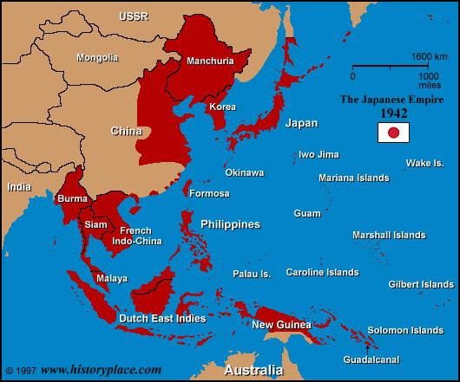

Slide 16
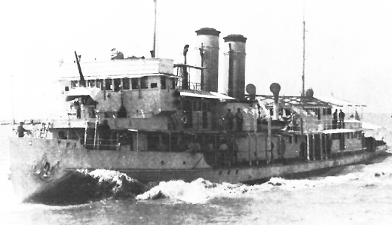

Slide 17
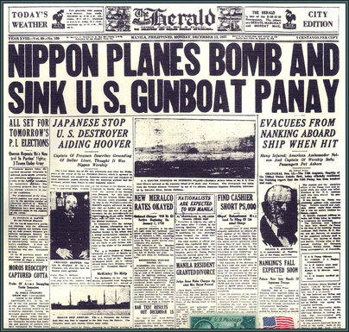

Slide 18
Japan Forces U.S. into War
December 7, 1941- Japan attacks U.S. Naval base in Pearl Harbor, Hawaii- Why?
They hoped to destroy enough U.S. ships allowing Japan to take over areas that had oil in the South Pacific.
2,403 U.S. service men are killed-
FDR declares war the next day- “A day that will live in infamy”
The U.S. was officially in WW2

Slide 20
